Slide 1
Malignant comment classifier project
Submitted by:
Abhilasha mewada

Slide 2
INTRODUCTION
Business Problem Framing
The proliferation of social media enables people to express their opinions widely online. However, at the same time, this has resulted in the emergence of conflict and hate, making online environments uninviting for users. Although researchers have found that hate is a problem across multiple platforms, there is a lack of models for online hate detection. Online hate, described as abusive language, aggression, cyberbullying, hatefulness and many others has been identified as a major threat on online social media platforms. Social media platforms are the most prominent grounds for such toxic behavior.

Slide 3
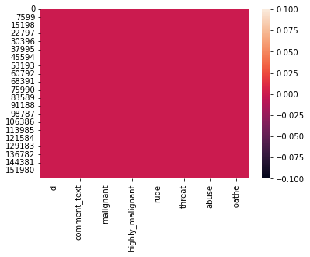
checking null values

Slide 4
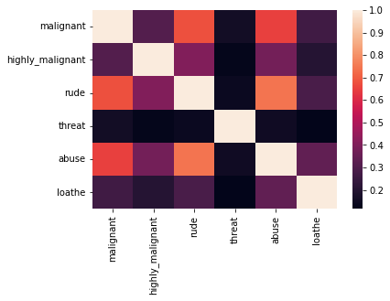
checking correlation in dataset

Slide 5
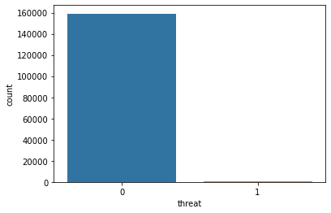
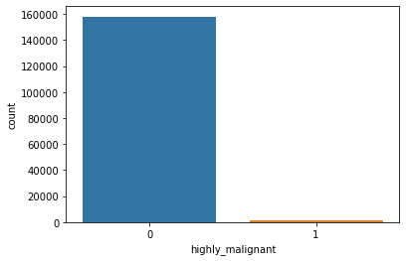

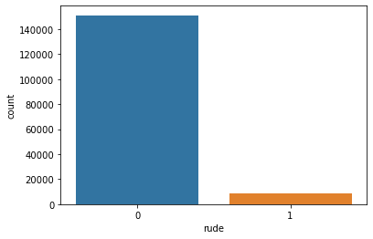

visualisation

Slide 6
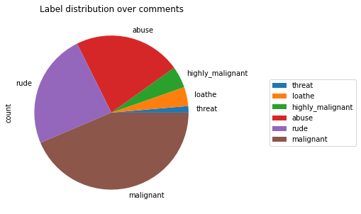
distribution of comments

Slide 7
Hardware and Software Requirements and Tools Used
import pandas as pd
import numpy as np
import matplotlib.pyplot as plt
import seaborn as sns
from sklearn.model_selection import train_test_split,GridSearchCV,cross_val_score
from sklearn.preprocessing import StandardScaler,MinMaxScaler,power_transform
from sklearn.linear_model import LinearRegression,LogisticRegression

Slide 8
Hardware and Software Requirements and Tools Used
from sklearn.metrics import r2_score, mean_squared_error,accuracy_score,roc_auc_score,roc_curve,confusion_matrix,classification_report
from sklearn.neighbors import KNeighborsClassifier
from sklearn.ensemble import AdaBoostRegressor,GradientBoostingClassifier
import warnings
warnings.filterwarnings('ignore')
from sklearn import preprocessing
import scipy.stats as stats
from scipy.stats import zscore
from sklearn.svm import SVC
from sklearn.tree import DecisionTreeClassifier
from sklearn.naive_bayes import MultinomialNB
import pickle
from nltk.stem import WordNetLemmatizer
import nltk
import string
from sklearn.linear_model import RidgeClassifier
from sklearn.tree import DecisionTreeClassifier
from sklearn.svm import SVC
from sklearn.ensemble import AdaBoostClassifier
from sklearn.ensemble import GradientBoostingClassifier
from sklearn.metrics import classification_report
from sklearn.feature_extraction.text import TfidfVectorizer

Slide 9
Matrices:
RD_model= RidgeClassifier()
DT_model= DecisionTreeClassifier()
SV_model= SVC()
KNR_model= KNeighborsClassifier()
ADA_model=AdaBoostClassifier()
GB_model= GradientBoostingClassifier()

Slide 10
CONCLUSION
While reading the dataset We find that peoples are criticise the most and all bad comments are than a good one. For our matrics the decision tree classifier give a best accuracy score on training dataset.

